Slide 1
Do Now
Elements arranged on the periodic table in periods (rows) and groups (columns).
Use your periodic table to answer the following questions on your whiteboard. Include the name and symbol of each element.
Which element is in period 4, group 2?
Which element is in period 2, group 18?
Which element is in period 5, group 12?
Write the period and group for the following elements:
Beryllium
Titanium
Tungsten

Slide 2
Element Symbols Year 8 Science

Slide 3
Learning Objectives
CFU
Which elements do you need to remember the names and symbols of?
Locate names and symbols of elements on the periodic table
Write element symbols correctly
Recall names and symbols of the first 20 elements
Activate Prior Knowledge
On your white board, draw a symbol that you have seen in day-to-day life that many people recognise.
Be prepared to share and see if your peers know what your symbol stands for!

Slide 4
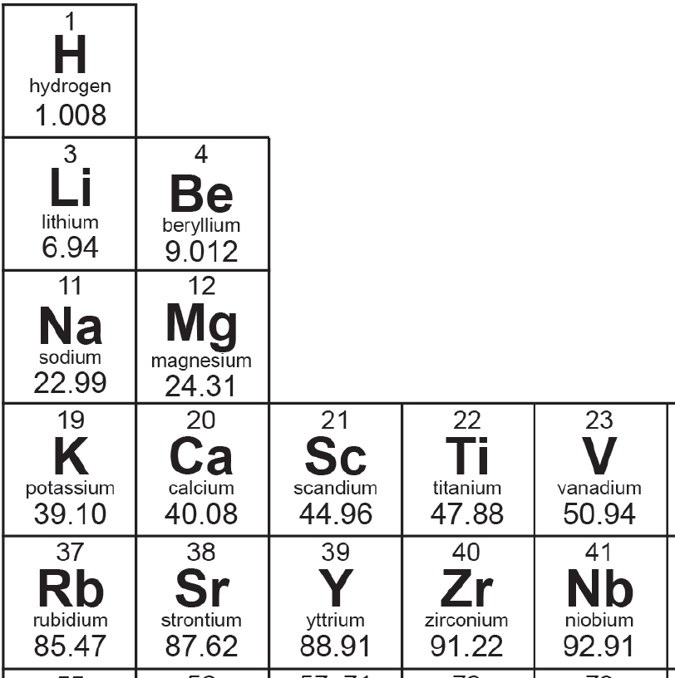
Concept Development
CFU 1
What are elements represented by on the periodic table?
Scientists use symbols to represent the names of different elements.
CFU 2
How many letters make up an element symbol?
On the periodic table, you will notice that elements are represented by their symbols.
Element symbols consist of one or two letters.
The first letter is always a capital, and if there is a second letter it is always in lower case.
CFU 3
How must all element symbols be written?

Slide 5
Skill Development / Guided Practice
CFU 1
The symbol for fluorine has one letter – what is it?
Element symbols always start with a capital letter. If a second letter is used, it is always written in lower case.
CFU 2
The symbol for bromine has two letters – what are they?
Most element symbols match the first letter and sometimes the second letter of the element name.
What is the element symbol for:
Hydrogen
Carbon
Iodine
Neon
Gallium
Calcium
H
C
I
Ne
Ga
Ca

Slide 6
Skill Development / Guided Practice
CFU 1
Where have the second letter in each of these element symbols come from?
Element symbols always start with a capital letter. If a second letter is used, it is always written in lower case.
Some element symbols match the first letter, but the second letter is not the same as the element name.
CFU 2
Arsenic is number 33 on the periodic table. What is its element symbol?
What is the element symbol for:
Magnesium
Chlorine
Zinc
Mg
Cl
Zn

Slide 7
Skill Development / Guided Practice
CFU 1
If an element’s symbol does not match its name, where does it usually come from?
Element symbols always start with a capital letter. If a second letter is used, it is always written in lower case.
Some element symbols do not match the element name.
These symbols have been taken from the Latin name of the element.
What is the element symbol for:
Sodium
Iron
Potassium
Copper
Silver
Tin
Gold
Lead
Na (natrium)
Fe (ferrum)
K (kalium)
Cu (cuprum)
Ag (argentum)
Sn (stannum)
Au (aurum)
Pb (plumbum)
CFU 2
Antimony is number 51 on the periodic table - what is its element symbol?

Slide 8
Relevance
Knowing the origin of an element’s symbol helps us understand why an element has that particular symbol.
Having a periodic table that scientists all share and agree on allows us to communicate with ease.

Slide 9
Skill Closure
Name the element with the symbol C.
Skill Closure
Write the symbol for nitrogen.
Skill Closure
Dante writes the symbol for Helium as HE. Is this correct? Explain your answer.

Slide 10
Independent Practice
Use the Quizlet activities below to help you memorise the first 20 element names and symbols.
https://quizlet.com/_6gcsd2
https://quizlet.com/_6gcwo8
If you do not have a device, create a set of element flash cards for yourself by:
Cutting a piece of paper up into cards
Writing the name of the element on one side and the symbol on the other
Keep your flash cards together with a paperclip or binder clip.

Slide 11
Independent Practice
1. Write the names of the elements below.
He
Al
N
Au
Ne
2. Write the symbols of the elements below.
Calcium
Argon
Oxygen
Silver
Lithium

Slide 12
Independent Practice
ANSWERS
1. Write the names of the elements below.
He Helium
Al Aluminium
N Nitrogen
Au Gold
Ne Neon
2. Write the symbols of the elements below.
Calcium Ca
Argon Ar
Oxygen O
Silver Ag
Lithium Li

